Slide 1
Pathways for BUSD Multiple Subject (MS) Holders to Add a Credential in Science or Physical Education
Presented by BUSD HR in Partnership with BFT
January 23, 2018, 3:30 pm- 5:30 pm,
District Office Room 125

Slide 2
Overview
Background: Increased Prep Release Periods in 18-19 for BUSD
Hiring Hierarchy for Teachers in CA
The Multiple Subject Holder’s Pathway to Teaching K-5 Science or PE
BUSD MS Holder’s Pathways to Teaching K-5 Science or PE Simplified
  The Examination Pathway (CSET)
  The Coursework Pathway (Supplementary Authorization or Specific Subject Matter Authorization)
The General Education Limited Assignment Teaching Permit (GELAP)
Question and Answers (Q & A)

Slide 3
Background: Increased Prep Release Periods
in 2018-19 for BUSD
Kinder: no change
1, 2, 3: Increasing from 1 prep weekly to 4 preps weekly
PE (2 preps) - district mandate
Music or Science (1 prep) - site choice
Any (1 prep) - site choice
4, 5: Decreasing from 5 preps weekly to 4 preps weekly
Music (2 preps)
Science (2 preps)
We will likely need to hire ~13 FTE new PE teachers.
Depending on what sites choose for their preps, we could need to hire from 1 to 5 FTE new science teachers.

Slide 4
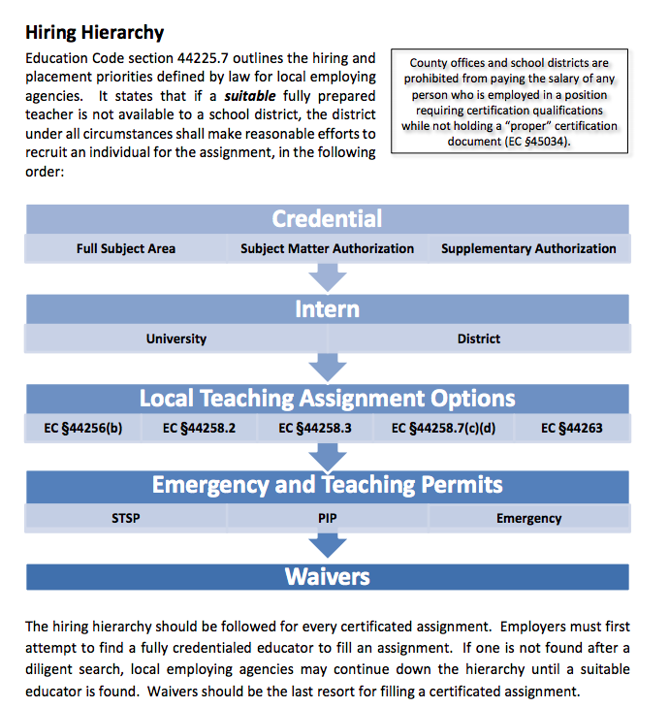
Hiring Hierarchy for Teachers in CA

Slide 5

Multiple Subject (MS) Holder’s Pathway
to Teaching K-5 Science or PE

Slide 6
Multiple Subject (MS) Holder’s Pathway
to Teaching K-5 Science or PE
The Coursework Pathway
*Supplementary Authorization (Supp Auth or SA)
*Subject Matter Authorization (SSMA)
The Examination Pathway
*Added Authorization

Slide 7
Multiple Subject (MS) Holder’s Pathway
to Teaching K-5 Science or PE
The Examination Pathway
*Added Authorization

Slide 8
The Examination Pathway
to add an Authorization (CSET)
If you hold a valid multiple or single subject credential. . .
Show subject-matter competence by passing the required CSET exam(s)
  PE: Subtest I (129), Subtest II (130) and Subtest III ( 131)
  Science: CSET 215 - Foundational Level General Science
Take a 3 semester (4 quarter) unit methodology course in that subject
Possess an English learner authorization (CLAD - SDAIE)
Submit test scores & application with fee to district office ($100)

Slide 9
MS Holder’s Possible Authorizations to Add via the California Subject Examinations for Teachers (CSET) & A 3 Semester Units Methods Course
PE | Science
Physical Education (CSET) consists of Subtest I (test code 129), Subtest II (test code 130) and Subtest III (test code 131) A Single Subject Teaching Credential in Physical Education authorizes teaching in all grades | Foundational-Level General Science (CSET) consists of Subtest I (test code 215) A Single Subject Teaching Credential in Foundational-Level General Science authorizes teaching only in general, introductory, and integrated science (integrated science through Grade 8 only). *Other science authorizations can be added by passing additional subject specific exams

Slide 10
CSET for Physical Education (PE)
PE: Subtest I (Code 129), Subtest II (Code 130) and Subtest III (Code 131)
Cost = $99 per subtest taken separately; $297 for all subtests taken together
  Subtest I & II: 40 multiple-choice and 2 constructed responses
  Subtest III: 40 multiple-choice and 1 constructed response
Subtests I and III: 1 hour and 45 minutes per subtest
Subtest II: 1 hour and 30 minutes
All 3 subtests in a single session: 5 hours
Passing score = 220 per subtest

Slide 11
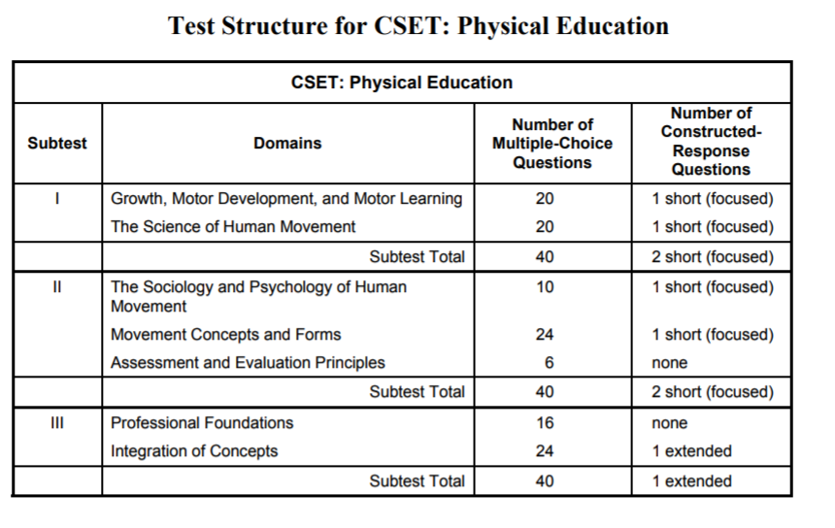
CSET for Physical Education (PE)

Slide 12
CSET for Science
We recommend CSET 215 - Foundational Level General Science
Subtest 1 only (cost=$133)
100 multiple choice questions & 4 constructed responses
Test time limit is 4 hours, passing score = 220
Optional Subtests for specific field area authorizations:
Subtest 2 choices (cost=$134): Life Sciences (217), Chemistry (218), Earth & Space Science (219), Physics (220)
50 multiple choice questions & 3 constructed responses
Test time limit is 2 hours, passing score = 220

Slide 13
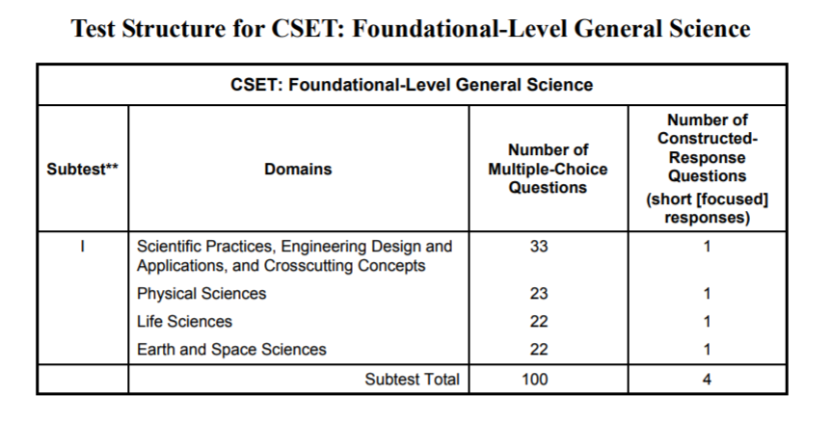
CSET for Science

Slide 14
Multiple Subject (MS) Holder’s Pathway
to Teaching K-5 Science or PE
The Coursework Pathway
*Supplementary Authorization (Supp Auth or SA)
*Subject Matter Authorization (SSMA)

Slide 15
The Coursework Pathway to add an Authorization (College Units)
A supplementary authorization may be added onto a multiple subject credential and authorizes the holder to teach that subject in grades 9 and below.
To apply for this authorization,
Fill out an application with HR to be sent to the CTC
Pay $100 application fee
Submit all relevant transcripts
** It is recommended that you approve all coursework with HR beforehand so you are assured the credits will count towards your authorization

Slide 16
MS Holder’s Possible Supplementary Authorizations to add via Coursework & No CSET Subject Exam
PE | Science
Physical Education Authorizes the holder to teach only grade 9 and below | Science Authorizes the holder to teach only grade 9 and below
20 semester units (or 10 upper-division semester units) of non-remedial coursework in the subject, completed at a regionally accredited community college, college, or university with specific course requirements for the authorization or a collegiate major in that subject .

Slide 17
The Coursework Pathway to add an Authorization (College Units)
To get this authorization, you must take 20 semester units and show that you have completed at least one course in each sub-area of the subject:
PE | SCIENCE
team sports and games fundamental and creative movement skills (such as dance and gymnastics) human movement motor development and/or motor learning individual, dual, nontraditional and global sports and games (such as aquatics, conditioning, and archery) | biological sciences chemistry geosciences physics Course of study must include a one-year sequence of courses in at least two of the listed subject areas. At least one course must include a laboratory component.

Slide 18
The BUSD REQUEST FOR COURSE APPROVAL FORM (Friendly Reminder)
This request must filled out in duplicate and submitted to the Human Resources Office preferably prior to the start date of the course for which approval is being requested but NO later than two weeks after the class start date. APPROVAL MUST BE OBTAINED for all course work taken for the purpose of progressing from one column to another column on the salary schedule.
You must submit transcripts by November 15th to qualify for salary column advancement for that school year. If transcripts are not available by November 15th, a letter of verification from the university or college specifying that the work has been completed will suffice pending transcript verification, but this letter must be submitted by November 15th.

Slide 19
The Coursework Pathway to add an Authorization (College Units)
What counts towards your 20 semester units:
YES | NO
Courses taken at a community college, college or university Non-remedial coursework in the subject Courses with a grade of “C” of higher | Remedial coursework (that can’t be applied towards a degree) Professional development, in-service training, workshops, continuing education units Education or methodology courses Coursework for another subject area

Slide 20
The Coursework Pathway to add an Authorization (College Units)
You can also choose to apply for a Specific Subject Matter Authorization instead of a Supplementary Authorization. The key differences:
You must either have a degree major or have taken 32 or more semester units in the specific subject area you want to apply for
You are then authorized to teach in any grade K-12
** It is recommended that you approve all coursework with HR beforehand so you are assured the credits will count towards your authorization

Slide 21
Hiring Hierarchy for Teachers in CA

Slide 22
(GELAP) General Education
Limited Assignment Teaching Permit
A GELAP permit is issued for teachers who are working towards an added authorization in a subject area that they do not currently have. It is valid for one year, and may be re-issued twice in a subject area.
The relevant & available subjects for the GELAP are:
Physical Education
Foundational-Level General Science
Science: Biological Sciences
Science: Chemistry
Science: Geosciences
Science: Physics

Slide 23
(GELAP) General Education
Limited Assignment Teaching Permit
To GET a GELAP, a teacher must:
Be currently employed by the requesting district (the district needs to have a “Declaration of Need for Fully Qualified Educators” on file with CTC) and consent to teach in that district under the permit
Already hold a valid California general education teaching credential
Be assigned an experienced educator in that subject area

Slide 24
(GELAP) General Education
Limited Assignment Teaching Permit
To RENEW a GELAP after one/two years, a teacher must:
Satisfy all the conditions to get the initial GELAP . . . and . . .
Complete one of the following:
  Complete 6 semester units of coursework towards the authorization
  Take all CSET exams needed for the authorization and pass at least two of the subtests

Slide 25

Questions & Answers

Slide 26
Next Steps
Useful Website Links
Contact Sheila Rose and Brent Daniels via email if you are interested in adding an authorization (via coursework or examination)
Talk to your principal if you are interested in a position at your school in PE or science but don’t yet have the authorization (for a GELAP)
BUSD Prior Course Approval Form:
http://www.berkeleyschools.net/wp-content/uploads/2014/10/Request-for-Course-Approval.pdf
CSET: http://www.ctcexams.nesinc.com/
CTC Application Form: https://www.ctc.ca.gov/docs/default-source/leaflets/414.pdf?sfvrsn=24453907_6
Supplementary Authorization Worksheet:
https://www.ctc.ca.gov/docs/default-source/leaflets/cl696b.pdf?sfvrsn=23bb22bd_0

